Slide 1
Exploratory Data Analysis on the Titanic Dataset
Objective: Understand survival patterns based on gender, class, age, and other features.
Tools Used: Python, Pandas, Seaborn, Matplotlib

Slide 2
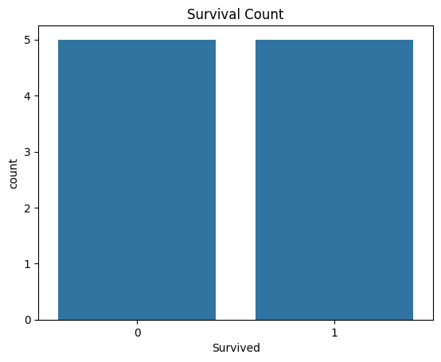
Survival count

Slide 3
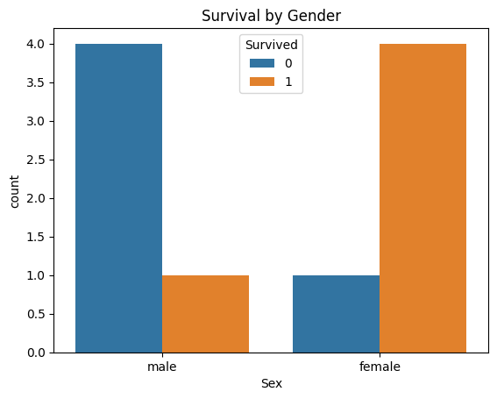
Survival by Gender

Slide 4
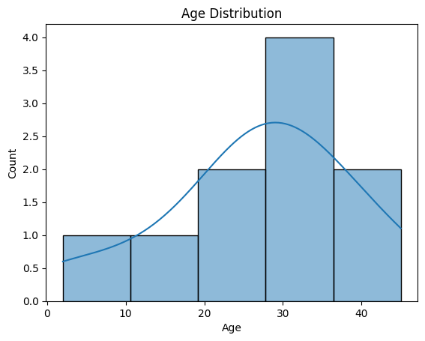
Age Distribution

Slide 5
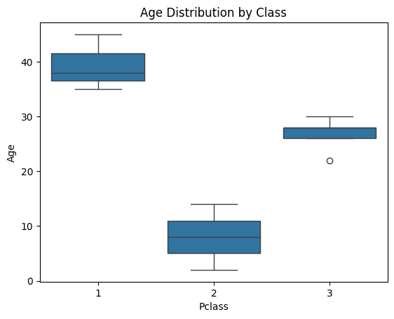
Age Distribution by Class

